Slide 1


ETA-X
Setup
(json file)
actions state: is_agent_action
state:
is_ext_input
Agent
Environment
FMU
observations state: is_agent_observation
state: is_ext_output
name variable in FMU:
ext_id

Slide 2

Setup (json- file)
Scenario data
Setup (json- file)
Class: BaseEnv
Class: BaseEnvSim
__init__()
__init__()
observations
step()
update()
actions
observations
Class: LiveConnect
Agent
Class: FMUSimulator
is_ext_input*
read()
step()
simulate()
is_ext_output*
is_ext_input*
is_ext_output*
FMU

Slide 3

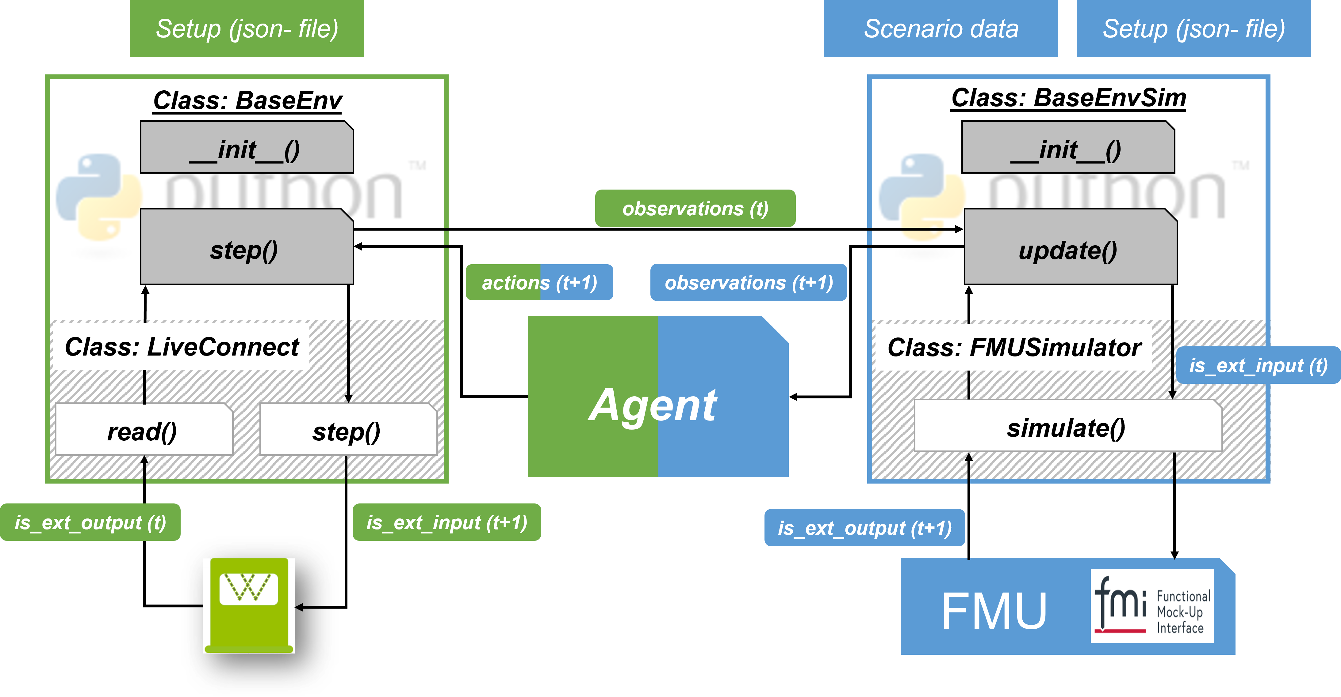
ETA-X
Interaction Environment
Environment

Slide 4
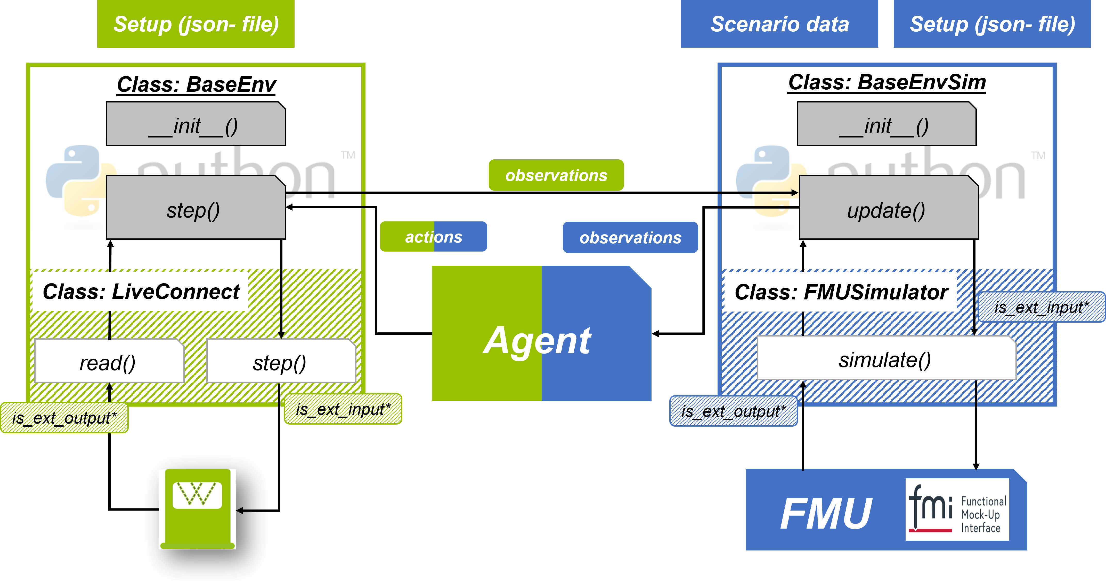
ETA-X
Interaction Environment
Environment
*: Specified in state_config

Slide 5
Quelle: https://raw.githubusercontent.com/modelica/MA-Logos/master/HighRes/Modelica_Association_Projects.svg
Abgerufen am 13.09.2021
Quelle:
https://www.python.org/static/community_logos/python-logo-master-v3-TM.png
Abgerufen am 13.09.2021

